Slide 1

Technique optimization
Slender Club
Grapsas Nikolaos
Consultant Cardiologist
“Agios Andreas” Hospital Patra

Slide 2
NO CONFLICTS

Slide 3
“Slender TRI”
Any technique can be considered to be “Slender” if associated with less trauma to the radial artery compared to traditional,
Usually the term “Slender” is applied when catheters <6 Fr are used.
The smallest available catheters in Japan are
  3 Fr for coronary angiography
  4 Fr for TRI

Slide 4
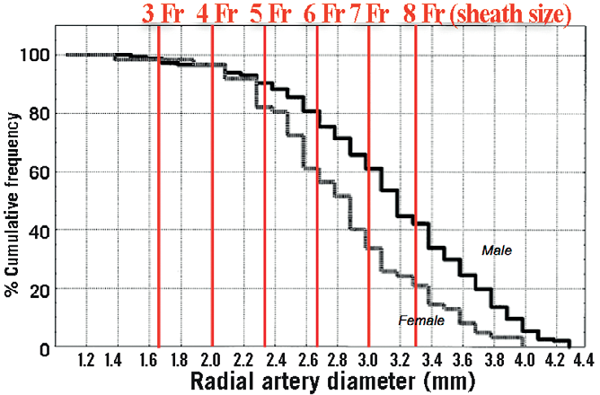
Radial artery diameter

Slide 5
Influence of the ratio between radial artery inner diameter and sheath outer diameter on radial artery flow after transradial coronary intervention
Saito S, Ikei H, Hosokawa G, Tanaka S.. Catheter Cardiovasc Interv 1999; 46: 173-8.

Slide 6
NAUSICA Trial
ClinicalTrials.gov identifier, NCT00815997

Slide 7
Crossover
Guiding catheter crossover
  4-Fr: poor support of the guiding catheter (n=3)
  6-Fr: radial spasm (n=1)
Access-site crossover
  4-Fr: puncture failure of the bil. radial arteries (n=1)
  6-Fr: radial spasm (n=1) and engage failure (n=1)

Slide 8
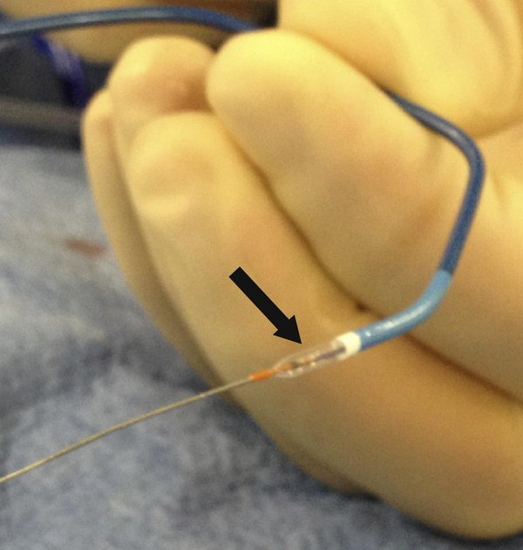
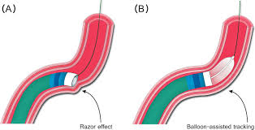
BALLOON-ASSISTED TRACKING
A 6 Fr or 5 Fr guide, loaded respectively with a 2.0 or 1.5 mm compliant balloon over a 0.014” coronary wire.

Slide 9
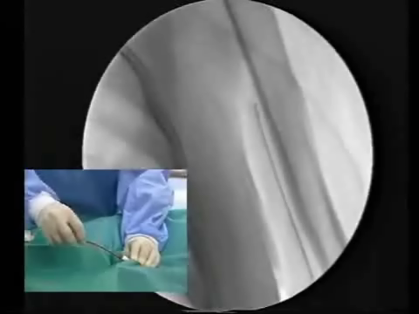
LONG DILATORS

Slide 10
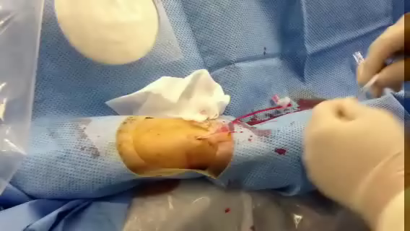
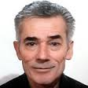

“Slender techniques”
Back-up-improving techniques
Loops
Anchor wire
Anchor balloon
Parallel wire
Mother and child
Special techniques for CTO
3F CA

Slide 11
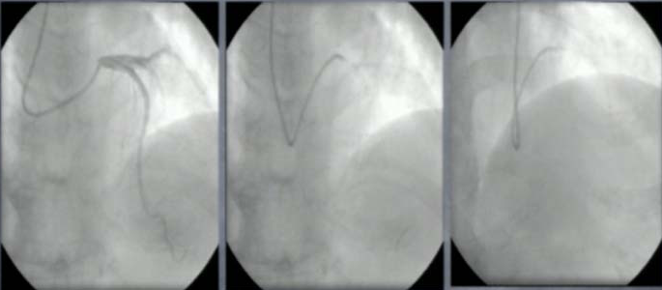
“γ” loop engagement
After engagement of JL, it is advanced with counterclock wise rotation or is advanced without rotation.
The catheter comes into contact the wall on the opposite side at the aorta and take on a shape like that of an Amplatz-type GC.
This technique as more useful to provide back up support for navigation into the CX than into LAD.

Slide 12
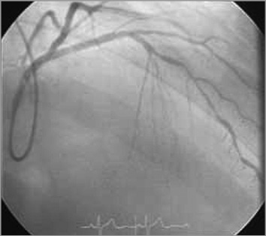
the α (alpha)-loop is used for LAD lesions
EuroIntervention 2015;10:1178-1186

Slide 13
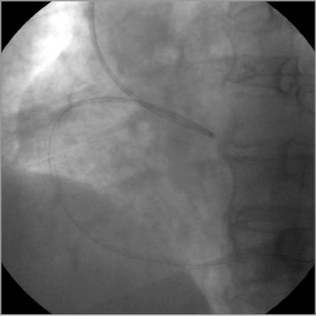
the ε (epsilon)-loop is used for RCA lesions
EuroIntervention 2015;10:1178-1186

Slide 14
ANCHOR WIRE
Second guidewire is inserted into the non-target coronary artery
Very useful when using a 4 Fr guide
Two 0.014” guidewires and a 3.0 mm balloon can pass through a 4 Fr guide.
However, two 0.014” wires and a stent cannot pass a 4 Fr guide.

Slide 15
ANCHOR BALLOON
A balloon is inflated distally in the target coronary artery to engage a 4 Fr or 5 Fr guide very deeply.
Retrieving the balloon, a stent can be delivered directly into the target lesion.
Differ from original anchor balloon technique,
  a balloon remains inflated on one wire while a stent is advanced on a second wire (6 or 7 Fr guides)

Slide 16
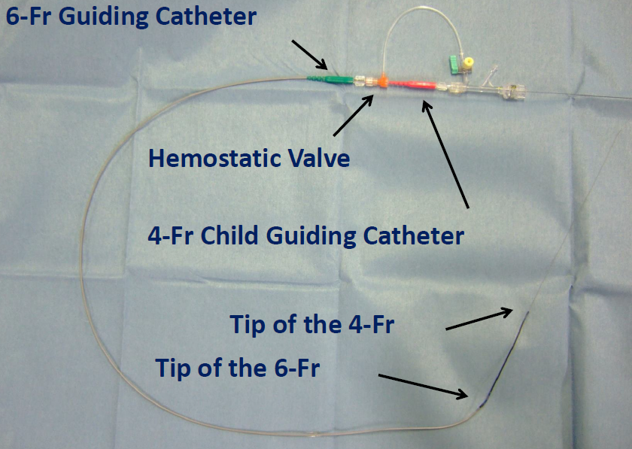
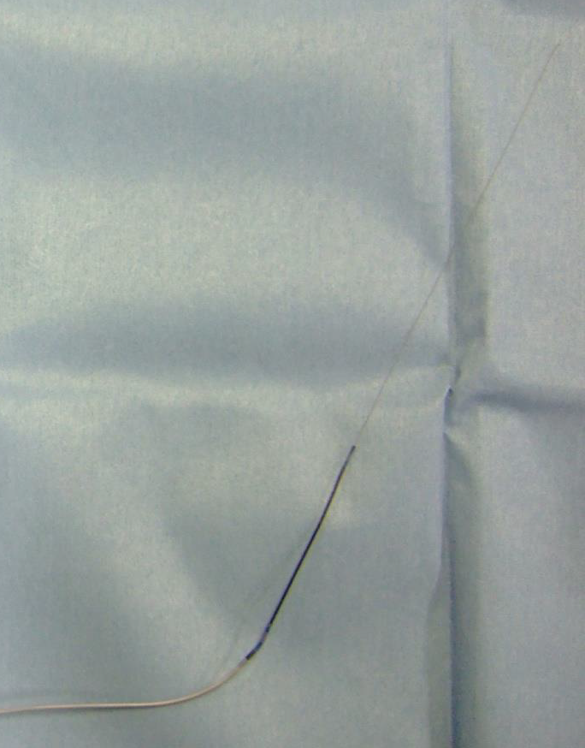
MOTHER AND CHILD
Introduction of a smaller bore catheter into the guide catheter in order to increase back-up support

Slide 17
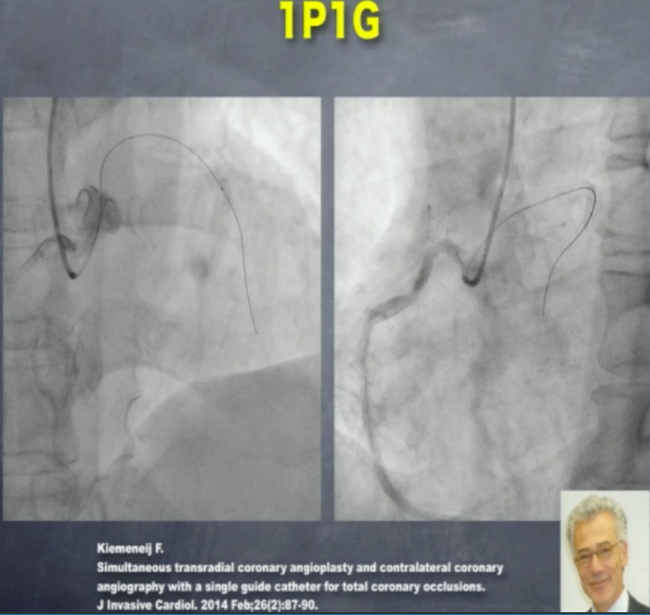

Slide 18
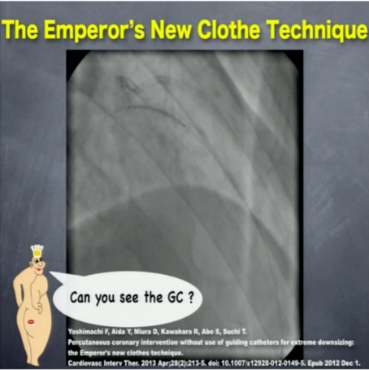
“the Emperor’s new clothes technique”
After coronary angiography using a 4 Fr diagnostic
catheter through a 4 Fr sheath, a guidewire was advanced through
the diagnostic catheter which was subsequently removed.
An IVUS catheter was used to determine the vessel diameter and lesion length.
Predilation balloon, and
stent were all advanced over the guidewire
The need for a guide catheter for visualisation
was obviated by application of IVUS

Slide 19

THANK YOU

Slide 20

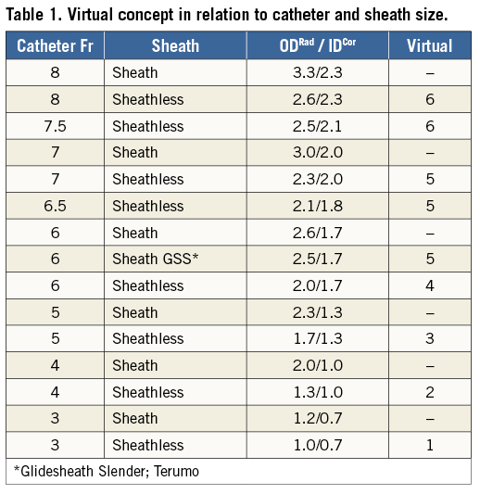
© 2015 EuroIntervention. All rights reserved.
EuroIntervention 2015;10:1178-1186 published online ahead of print September 2014
Focus on maximal miniaturisation of transradial coronary access materials and techniques by the Slender Club Japan and Europe: an overview and classification

Slide 21
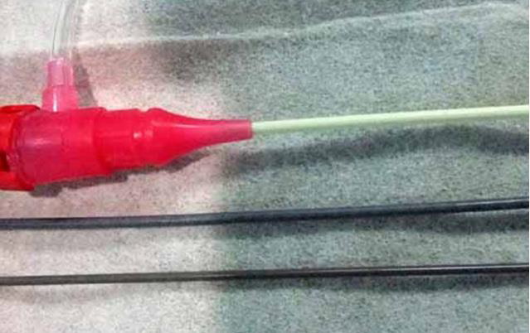
4 French Introducer Sheath
Virtual 3 French Guiding
4 French Coronary Accessor

Slide 22
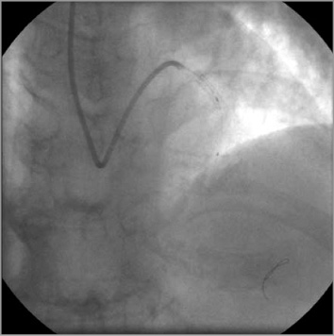
© 2015 EuroIntervention. All rights reserved.
EuroIntervention 2015;10:1178-1186

Slide 24
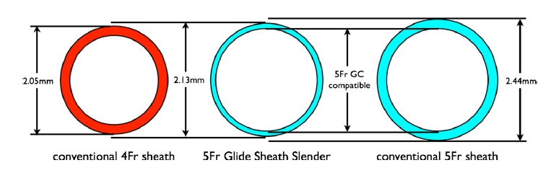

Slide 25
The Distribution of Radial Artery Diameter
Saito S, Ikei H, Hosokawa G, Tanaka S.. Catheter Cardiovasc Interv 1999; 46: 173-8.

Slide 26
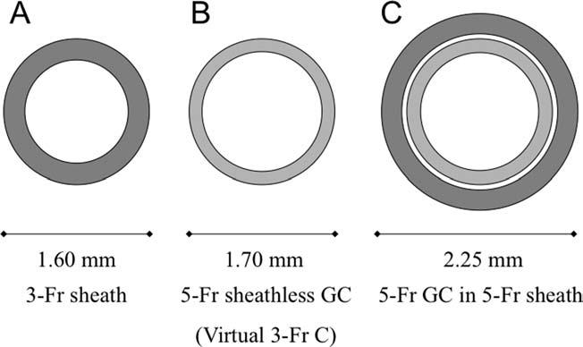

Slide 27
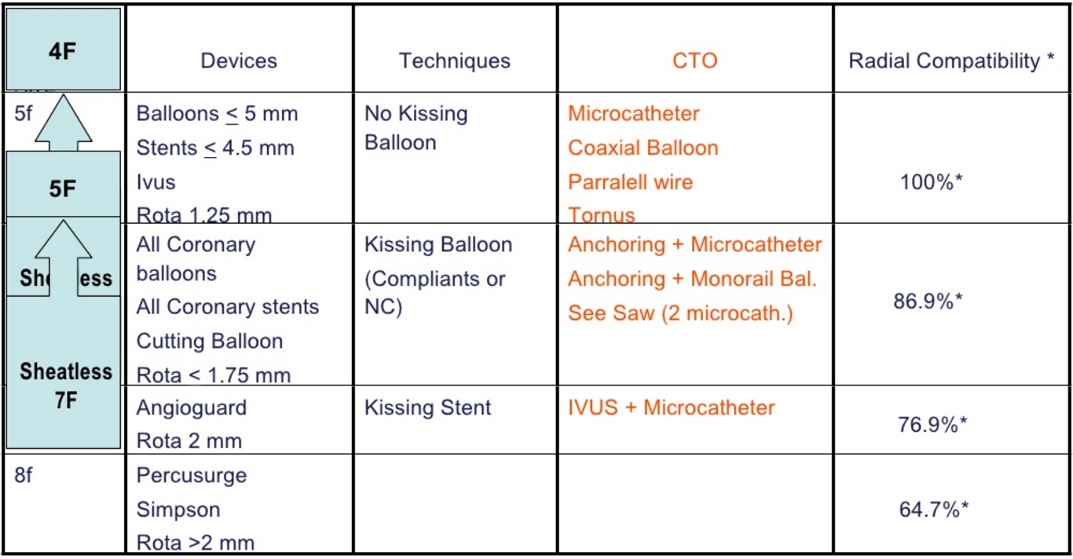
Catheter-Devices-CTO Compatibility

